Slide 1

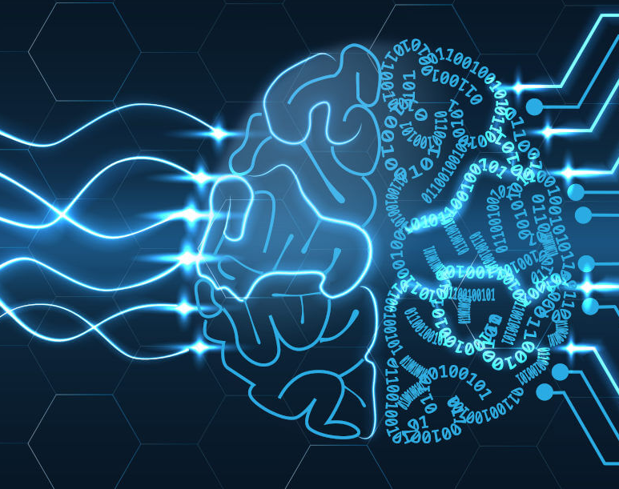
Predicting Drug Consumption through Personality Traits
Lorenzo Gini, Francesca Giacco, Dominik Cramer
Image source: https://www.ionos.de/digitalguide/online-marketing/suchmaschinenmarketing/deep-learning-vs-machine-learning/
Notes:
In our machine learning project, we predicted drug consumption through personality traits.
Drug policies are expensive, ineffective, and often highly problematic in most western countries. One important problem is that the cost of drug prevention and education is hard to justify due to the prevention paradox.

Slide 2
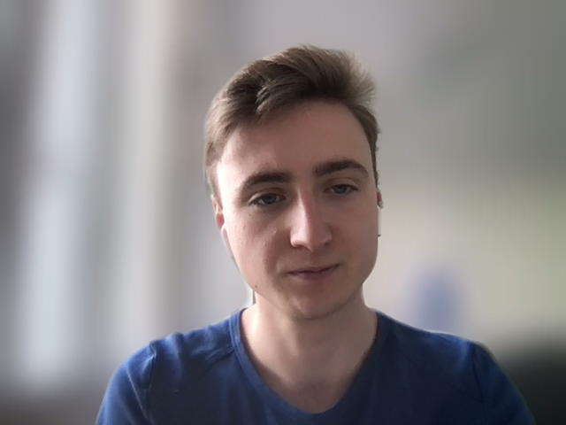
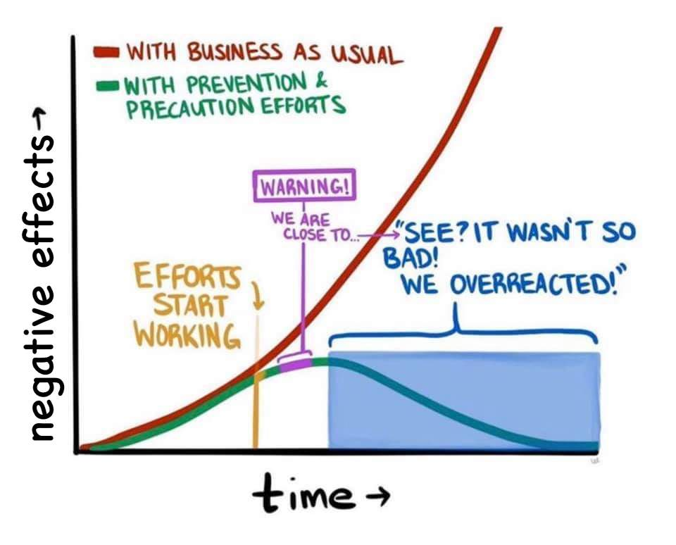
The Prevention Paradox
Image source: https://twitter.com/bverheggen/status/1362799317510197258
Notes:
This is because the negative effects of drug abuse are situated in the future and not equally likely to affect everyone.
But what if we could foresee who will be most susceptible to drug misuse in the future? Then, drug prevention could be targeted to those who need it, saving money and improving the justification for the spendings remaining. In our project, we took a shot at this challenge to foresee drug misuse.

Slide 3

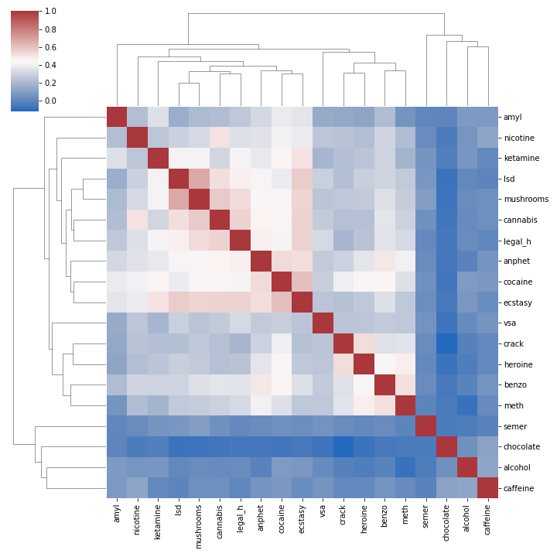
Correlation between substances
Image source: Own representation
Notes:
We used machine learning methods to predict who is most susceptible to which drugs according to their personality.
First of all, we divided drugs into three categories, namely depressants, hallucinogens and stimulants. The intuition was that different personalities would look for certain effects rather than specific drugs.

Slide 4

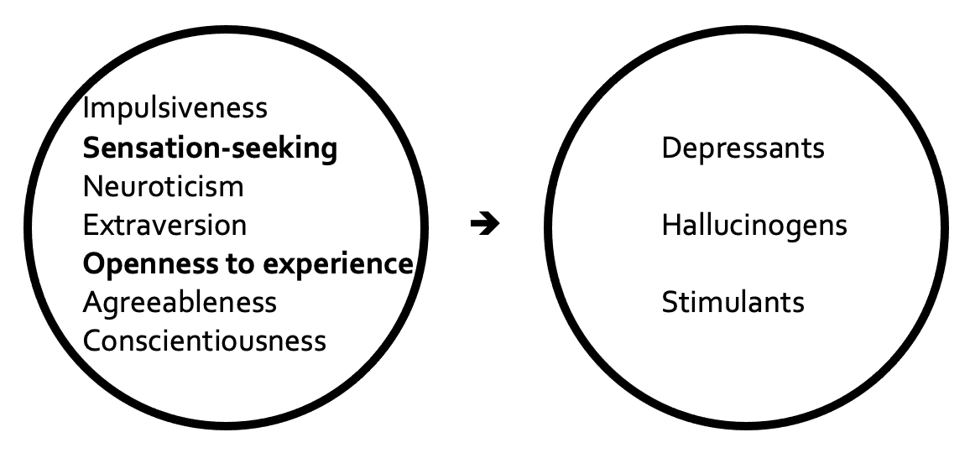
Methodology
Image source: Own representation
Notes:
After testing several models with several variants, we found that openness to new experiences and sensation-seeking have a considerable influence on the consumption of all 3 types of drugs, even if with different strengths. These results could potentially be used to predict future drug consumption when combined with data on demographics.
However, there are a few challenges to overcome before drug policies can be improved based on such predictions. On the technical side, the most important challenge is to collect a LOT more high-quality data on drug consumption and personality traits. The used dataset – which is the only one publicly available – contains just over 1,800 instances mainly from the US and UK. Data collection is difficult not least because of the stigma associated with drug consumption.
This also points to the most important non-technical challenge. As long as drug consumers and addicts are regarded primarily as criminals instead of patients, predicting drug consumption will be an ethically delicate if not infeasible basis for conduction of prevention policies.

Slide 5

References
Fehrman, Elaine, et al. "The five factor model of personality and evaluation of drug consumption risk." Data science. Springer, Cham, 2017. 231-242.
Fehrman, Elaine, et al. “Drug consumption (quantified) Data Set” https://archive.ics.uci.edu/ml/datasets/Drug+consumption+(quantified)
Notes:
In the end, our project mainly shows where the technical challenges lie and that they are solvable. But if machine learning methods are to be used to the benefit of society as a whole in drug policy, additional hurdles need to be cleared.

